Slide 1
Basics of Electronics Engineering Topic- Rectifiers

Slide 2
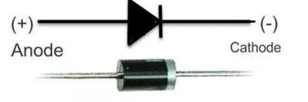
Introduction
A rectifier is a circuit which converts the alternating current (AC) input power into Direct current (DC) output power.
Diode and SCR are commonly used in rectifiers circuit.

Slide 3
Difference between AC and DC signals
AC (ALTERNATING CURRENT) | DC (DIRECT CURRENT)
AC signal flows one way, then other way continually reverses the direction. | Direct current always flows in same direction, but it may increase or decrease.
Continually changing between positive (+) and negative (-). | A DC signal is always positive (or always negative), but it may increase and decrease.
Rate of changing direction is called frequency of the AC and measured in Hertz (Hz). | Frequency is zero.

Slide 4
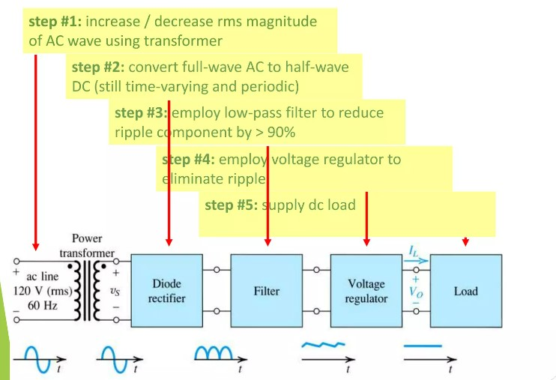
Rectification process

Slide 5
Types of Rectifiers
Half wave Rectifier
Centre tapped Rectifier
Bridge Rectifier

Slide 6
Half wave rectifier
In half wave rectification, either the positive or negative half of the AC wave is passed, while the other half is blocked.
Because only one half of the input waveform reaches the output, it is very inefficient if used for power transfer.

Slide 7
Half wave rectifier working animation

Slide 8
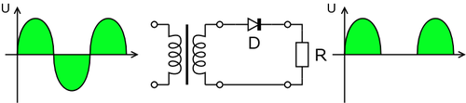
Half wave rectification

Slide 9
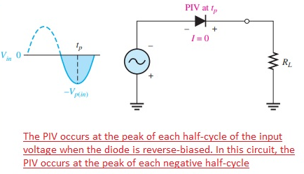
Peak Inverse Voltage
Peak Inverse Voltage (PIV) is the maximum voltage that the diode can withstand during reverse bias condition. If a voltage is applied more than the PIV, the diode will be destroyed.

Slide 10
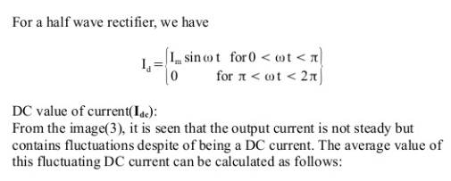
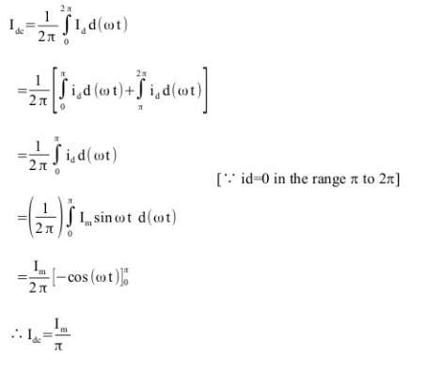
Half Wave Rectifier Calculations

Slide 11
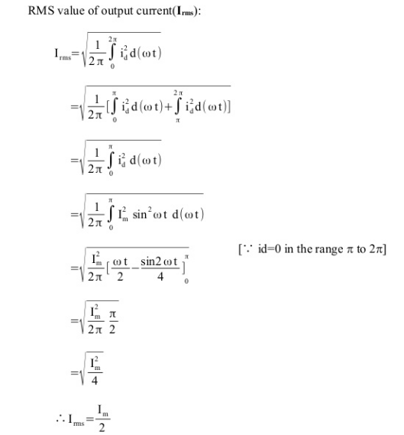
Half Wave Rectifier Calculations

Slide 12
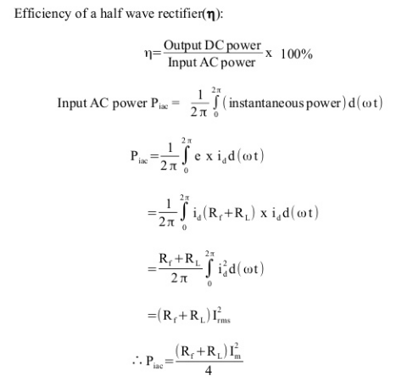
Efficiency of Half wave Rectifier

Slide 13
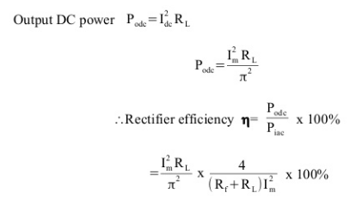
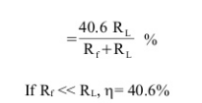
Efficiency of Half wave Rectifier contd.

Slide 14
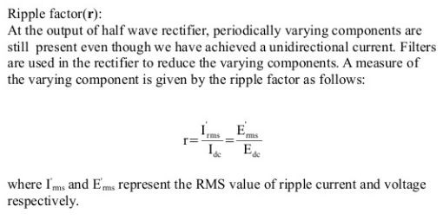
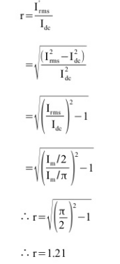
Half Wave Rectifier Calculations

Slide 15
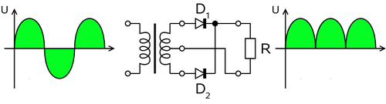
Centre Tapped Full wave rectifier
For single-phase AC, if the transformer is center-tapped, then two diodes back-to-back (i.e. anodes-to-anode or cathode-to-cathode) can form a full-wave rectifier.

Slide 16
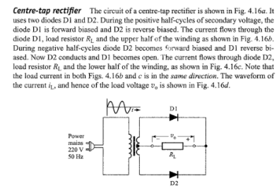
Centre Tapped Full wave rectifier

Slide 17
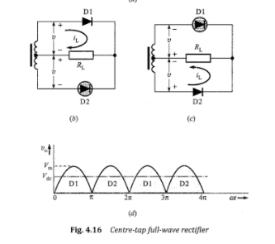
Centre Tapped Full wave rectifier

Slide 18
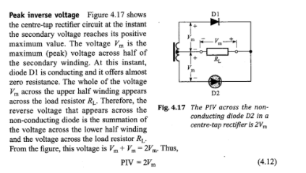
PIV of Centre Tapped Rectifier

Slide 19
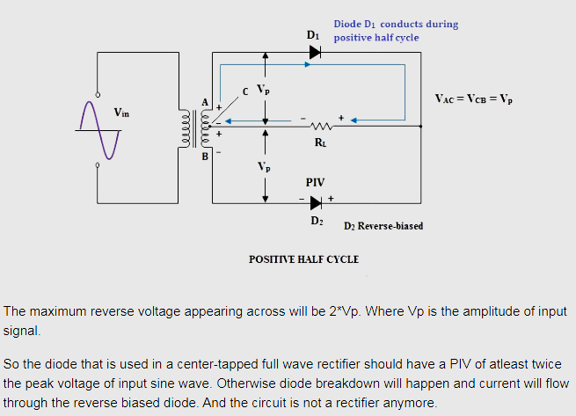
PIV of Centre Tapped Rectifier

Slide 20
Bridge Rectifier
A bridge rectifier is an alternating current (AC) to direct current (DC) convertor.
It rectifies mains AC input to DC output.
Bridge rectifiers are widely used in power supplies.
It requires four diodes instead of two, but avoids the need for a centre-tapped transformer.

Slide 21
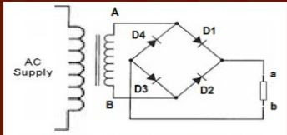
Bridge Rectifier
It consist of four diodes D1, D2, D3, D4 and step down transformer with load connected resistance.
The AC voltage is first applied to primary of the transformer which is step down with the step down transformer and applied to the secondary of the transformer.
Bridge rectifier

Slide 22
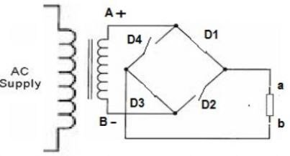
Bridge Rectifier
During positive half cycle of applied voltage:
Point A becomes at positive potential (+) whereas point B will be at negative potential (-). So diode D1 and D3 becomes forward bias and behave like a closed switch whereas diode D2 and D4 becomes in reverse bias and behaves like an open switch.
Equivalent circuit of bridge rectifier during positive half cycle

Slide 23
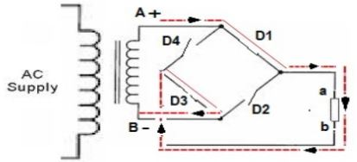
Bridge Rectifier
So current will start to flow from point A through diode D1 to the point B through load resistance RL to point b through diode D3 and finally reaches to point B.
In this way the direction of current through load resistance RL is from small a to small b.
Shows the current direction through load resistance RL: A-D1-a-RL-b-D3-B

Slide 24
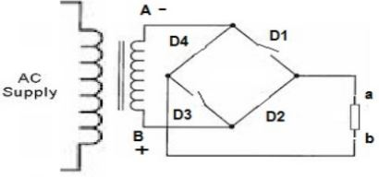
Bridge Rectifier
During negative half cycle:
Point A will be at negative potential (-) whereas point B will be at positive potential.
So diode D1 and D3 comes in reverse bias and behaves like an open switch whereas diode D2 and D4 comes in forward bias and behaves like closed switch.
Equivalent circuit of bridge rectifier during negative half cycle

Slide 25
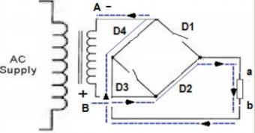
Bridge Rectifier
So during negative half cycle, current will start to flow from point B through diode D2 to the point a through load resistance RL to point b to diode D4 and finally reaches to point A.
In this way the direction of current through load resistance RL is from small a to small b
Fig Shows the current direction through load resistance RL: B-D2-a-RL-b-D4-A

Slide 26
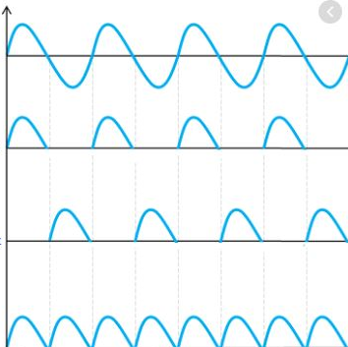
Bridge Rectifier Waveforms
In this way, Bridge rectifier convert both cycles of an AC voltage into DC.
AC input
D1, D3 current
D2, D4 current
Total output current

Slide 27
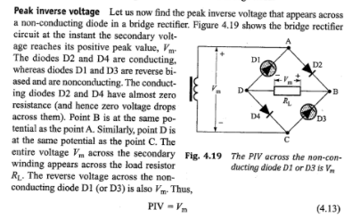
PIV Bridge Rectifier

Slide 28
PIV Bridge Rectifier
PIV (Peak inverse Voltage): At any instant when the transformer secondary voltage attains positive peak value Vmax, diodes D1 and D3 will be forward biased (conducting) and the diodes D2 and D4 will be reverse biased (non conducting). If we consider ideal diodes in bridge, the forward biased diodes D1 and D3 will have zero resistance. This means voltage drop across the conducting diodes will be zero. This will result in the entire transformer secondary voltage being developed across load resistance RL.
Thus PIV of a bridge rectifier = Vmax (max of secondary voltage)

Slide 29
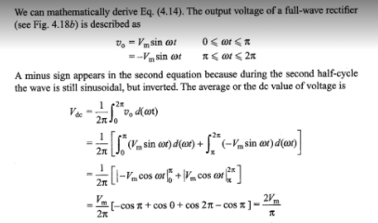
Full Wave Rectifier Calculations: 1. DC Voltage

Slide 30
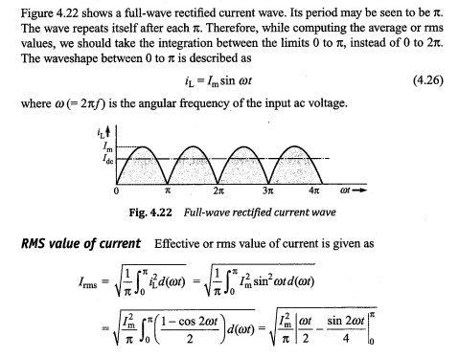
Full Wave Rectifier Calculations:

Slide 31
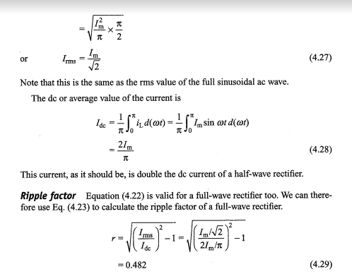
Full Wave Rectifier Calculations:

Slide 32
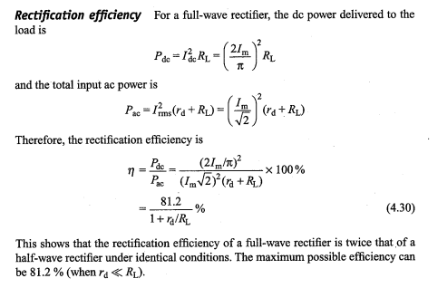
Full Wave Rectifier Calculations:

Slide 33
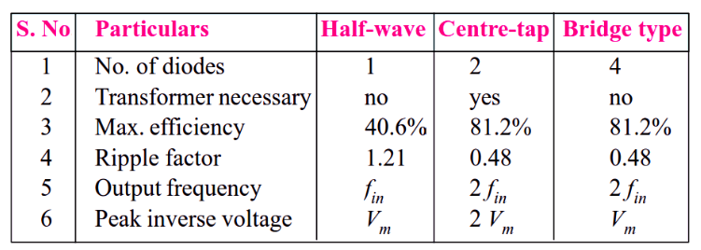
Comparison of different Rectifiers

Slide 34
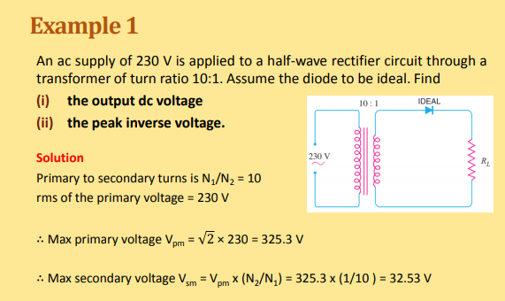
Numericals

Slide 35
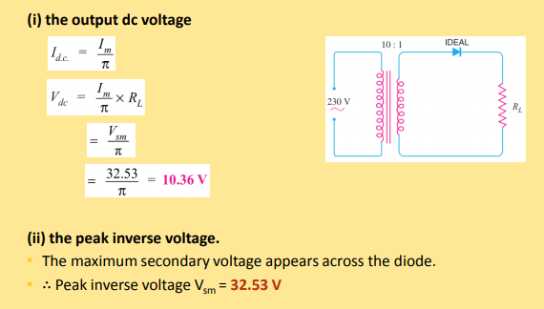
Numericals

Slide 36
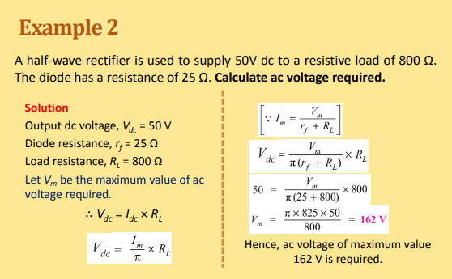
Numericals

Slide 37
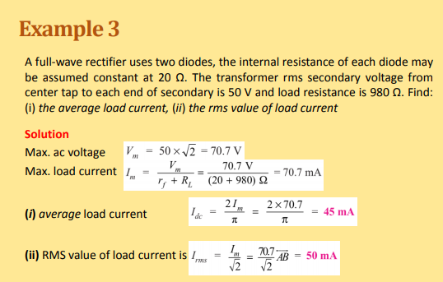
Numericals

